Slide 1
The Visitor Design Pattern
Darshan Sarvaiya (212308014)
Smit Thakar (212308045)
Present To : Ajay Parikh

Slide 2
Problem & Constraint
Problem
  Imagine you have a zoo with different types of animals: lions, monkeys, and elephants. You want to perform various operations on these animals, such as feeding them, taking their weight, and checking their health.

Slide 3
Possible Solutions
By Taxi
By Auto
By Bus
By Train

Slide 4
Solution
The Visitor pattern represents an operation to be performed on the elements of an object structure without changing the classes on which it operates. This pattern can be observed in the operation of a taxi company. When a person calls a taxi company (accepting a visitor), the company dispatches a cab to the customer. Upon entering the taxi the customer, or Visitor, is no longer in control of his or her own transportation.

Slide 5
Intent
Represent an operation to be performed on the elements of an object structure. Visitor lets you define a new operation without changing the classes of the element on which it operates.

Slide 6
Motivation
Problems with this approach:
  Adding new operations requires changes to all of the node classes
  It can be confusing to have such a diverse set of operations in each node class. For example, mixing type-checking code with pretty-printing code can be hard to understand and maintain.

Slide 7
Solution
Solution is to encapsulate a desired operation in a separate object, called a visitor. The visitor object then traverses the elements of the tree. When an tree node "accepts" the visitor, it invokes a method on the visitor that includes the node type as an argument. The visitor will then execute the operation for that node - the operation that used to be in the node class.

Slide 8
Participants
Visitor
  Declares a Visit operation for each class of ConcreteElement in the object structure.The operation's name and signature identifies the class that sends the Visit request to the visitor.That lets the visitor determine the concrete class of the element being visited.Then the visitor can access the element directly through its particular interface.

Slide 9
Participants
ConcreteVisitor
  Implements each operation declared by Visitor. Each operation implements a fragment of the algorithm defined for the corresponding class of object in the structure. ConcretVisitor provides the context for the algorithm and stores its local state. This state often accumulates results during the traversal of the structure.

Slide 10
Participants
Element
  Defines an Accept operation that takes a visitor as an argument.
ConcreteElement
  Implements an Accept operation that takes a visitor as an argument.
ObjectStructure
  May provide a high-level interface to allow the visitor to visit its elements.

Slide 11
Collaboration
A client that uses the Visitor pattern must create a ConcreteVisitor object and then traverse the object structure,visiting each element with the visitor.
When an element is visited, it calls the Visitor operation that corresponds to its class. The element supplies itself as an argument to this operation to let the visitor access its state, if necessary.

Slide 12
Consequences
Advantages
  Adding new operations is easy.
  Move multiple versions of the same behavior into the same class.
  Related behavior isn't spread over the classes defining the object structure. it's localized in a visitor. Unrelated sets of behavior are partitioned in their own visitor subclasses.

Slide 13
Consequences
Disadvantages
  Needs to update all visitors each time a class gets added to or removed from the element hierarchy.
  Visitors might lack the necessary access to the private fields and methods of the elements that they're supposed to work with.

Slide 14
Related Pattern
Composite
  Visitors can be used to apply an operation over an object structure defined by the Composite pattern.
Interpreter
  Visitor may be applied to do the interpretation.

Slide 15

Account Visitor Interface

Slide 16
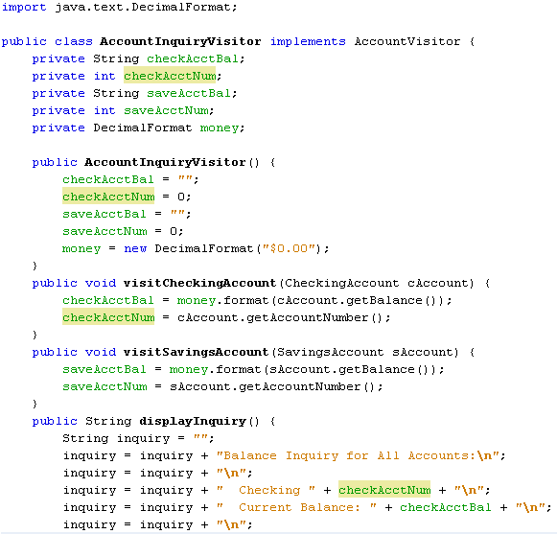
Inquiry Visitor

Slide 17

Account Interface

Slide 18
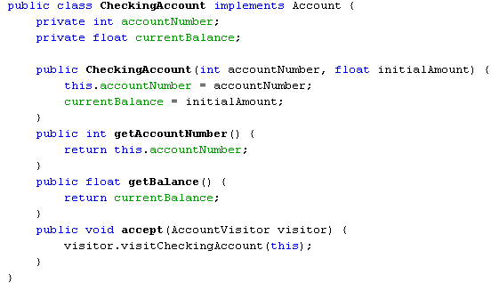
Checking Account
Notes:
Note: the accept() method here displays double dispatch. When a checkingAccount object calls the accept method with a visitor parameter it is allowing the visitor access to it’s functions.
- done by accepting the visitor and the visitor method accepting the checkingAccount object.

Slide 19
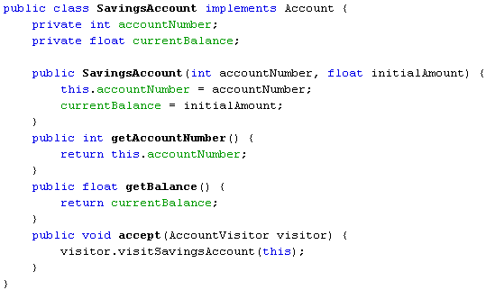
Savings Account
Notes:
Double dipatch here as well

Slide 20
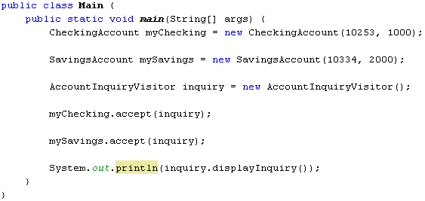
Main Method
Notes:
Both accept methods are now actually implementing the double dispatch, allowing the visitor pattern to actually work.

Slide 21
References
Refactoring-Guru :-
  https://refactoring.guru/design-patterns/visitor
Tutorials-Point :-
  https://www.tutorialspoint.com/design_pattern/visitor_pattern.htm
Digital-Ocean :-
  https://www.digitalocean.com/community/tutorials/visitor-design-pattern-java

Slide 22

Thank you

